Slide 1
NOTICE!
These materials are prepared only for the students enrolled in the course Distributed Software Development (DSD) at the Department of Computer Science and Engineering, University of Mälardalen, Västerås, Sweden and at the Faculty of Electrical Engineering and Computing, University of Zagreb, Croatia (year 2013/2014).
For all other purposes, authors’ written permission is needed!
The purpose of these materials is to help students in better understanding of lectures in DSD and not their replacement!
13-10-23
<Nummer>

Slide 2
Distributed Software Development
13-10-23
<Nummer>

Slide 3
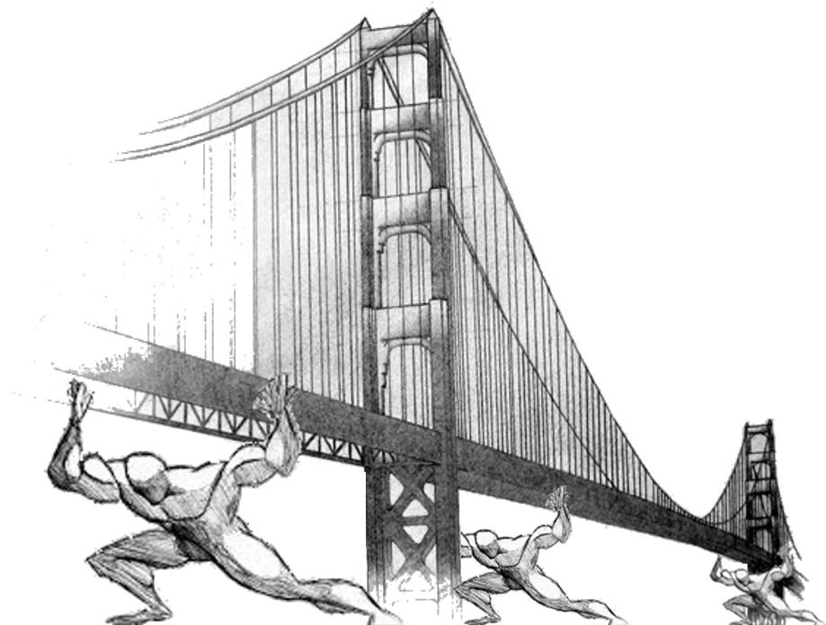
All the team
Real-Time Bridge Monitoring
Project Vision
13-10-23
<Nummer>

Slide 4
Overview
Team Organization
  The Group
  Roles and Responsabilities
  Team Communication
System description
  Real-Time Bridge Monitoring System
  Functionalities
Architecture and Technologies
13-10-23
<Nummer>

Slide 5







Team Organization
The Group
  PoliMi Team
Andrea Bottoli (PoliMi) Lorenzo Pagliari (PoliMi) Marko Brčić (FER)
  MDH Team
Dzana Kujan (MDH) Jörn Tillmanns (MDH) Miraldi Fifo (MDH) Nikola Radisavljevic (MDH)
13-10-23
<Nummer>

Slide 6
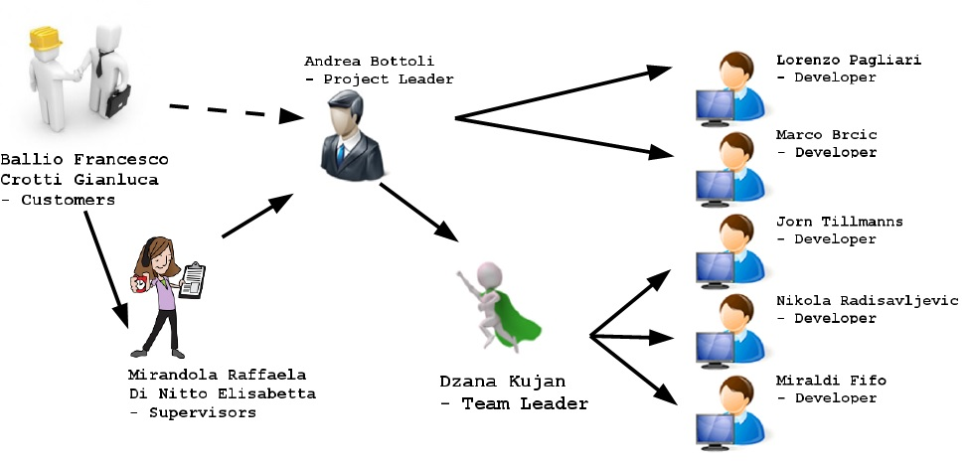
Team Organization
Roles and Responsabilities
13-10-23
<Nummer>

Slide 7




Team Organization
Communication
13-10-23
<Nummer>

Slide 8
System Description
Real-Time Bridge Monitoring
  People must take decisions during crisis
  Based on confident data from math formulas
    Bridge condition
    Structural damage
    Stresses
  Store historical data to make some statistics
  Show data on local and remote UI
  User friendly UI
13-10-23
<Nummer>

Slide 9
System Description
Functionalities (I)
  Gather sensors's informations
    Anemometer: wind speed
    Hydrometer: water level
    Echo sounder: river bed depth
    Cam: pillars pictures
  Store informations into a DB
    Current data
    Historical data
13-10-23
<Nummer>

Slide 10
System Description
Functionalities (II)
  Make calculations on the data
    Structural calculations, stresses, ...
  Display data to users
  Alert the users (pop up, e-mails, ...)
    Green: “ok, it's good”
    Yellow: “wait a moment...something's wrong”
    Red: “ALARM, bridge is crashing down!!!!”
  Personalize bounds, views, ...
13-10-23
<Nummer>

Slide 11
System Description
Functionalities (III)
  Graphs and statistics (with personalizations)
    Display and browsing temporal trends
    ...the flood is increasing his speed...
    ...the wind is changing speed...
    ...last year when X happened, Y happened...
  Web Services
    Remote users could use the system functionalities
    Tablets, Smartphones, ...
13-10-23
<Nummer>

Slide 12
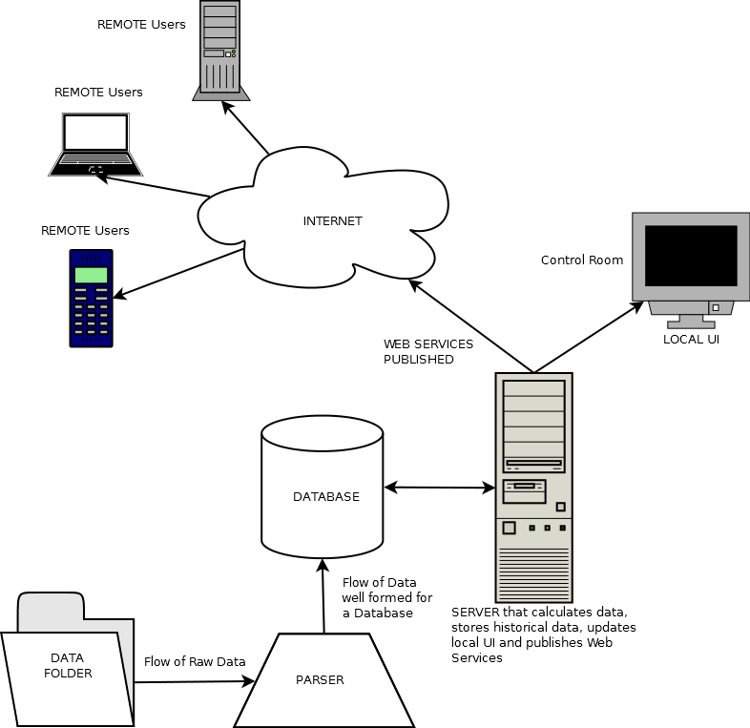
Architecture
13-10-23
<Nummer>

Slide 13
Architecture
Python
13-10-23
<Nummer>

Slide 14
Architecture
MySQL
Python
13-10-23
<Nummer>

Slide 15
Architecture
Java
& Java Servlets
MySQL
Python
13-10-23
<Nummer>

Slide 16
Architecture
HTML
Java
& Java Servlets
MySQL
Python
13-10-23
<Nummer>

Slide 17
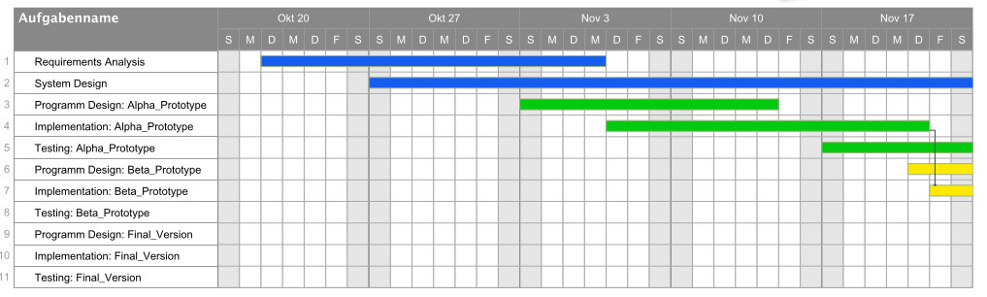
Project Plan
20.10 - 23.11
Notes:
We will use elements from the waterfall and incremental development process in order to fulfill both the requirements of the customer and the course. The documentation will be delivered in a waterfall kind of way, sequentially. However, the requirements and design phase will be distributed throughout the whole project, with multiple increments of the system being delivered after a certain amount of time.
In the first phase of our project we will focus to prepare the Implementation and build a good basis for later work. For this we have the two main aspects, the analysis of requirements and the design of the system. In this phase we will organize the project sequential as known from the waterfall model.

Slide 18

Project Plan
24.11 – 28.12
Notes:
In the waterfall model the phase of system design is normally followed by the Design of the Program. At this point we want to leave the normal waterfall model and choose a incremental model. Instead of only on phase of program design, implementation and testing, we bundle this three phases to a packet and repeat this packet three time. After the first bundle of program design, implementation and testing, we will be able to deliver the customer the first alpha prototype.
Because of the mix between the classical Waterfall model and an incremental development process. we are able to provide a high quality during this project. During the first stage we will figure out what we have to do and in witch way we will solve the problem. In this phase the contact with the customer is very important.
After the next phase we provide the alpha prototype. So the customer has the possibility to see the direction of the development.. The same is after the beta prototype.
In the last stage, we planed the last two weeks for testing and bug fixing. So we could be able to deliver a product with best quality.

Slide 19
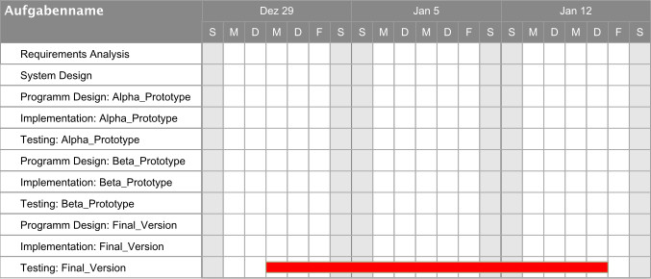
Project Plan
22.10 - 22.11

Slide 20
Risks
Communication:
  Within distributed groups (SWE, ITA, CRO)
  Within the team
  With customer
Still unknown input data and data format
Unclear requirements

